Slide 1
Administrative Employees and Faculty
Online Leave Reporting Training Presentation

Slide 2
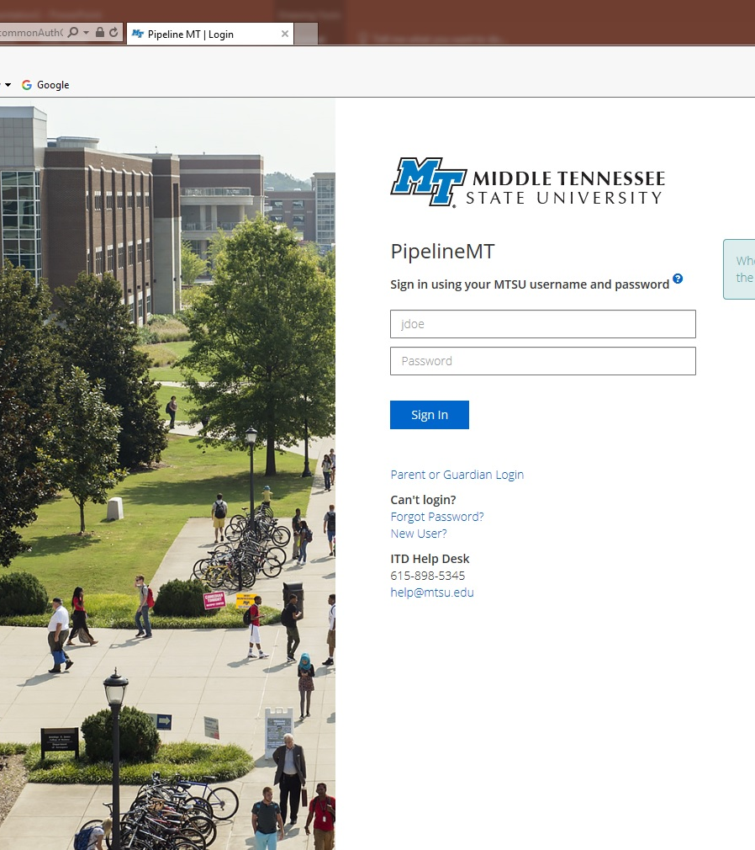
PipelineMT Login Page
www.mtsu.edu/pipelinemt
Log in to your account by using your MTSU username and password.
If you need assistance logging into your PipelineMT account contact the MTSU Helpdesk at help@mtsu.edu or 615-898-5345

Slide 3
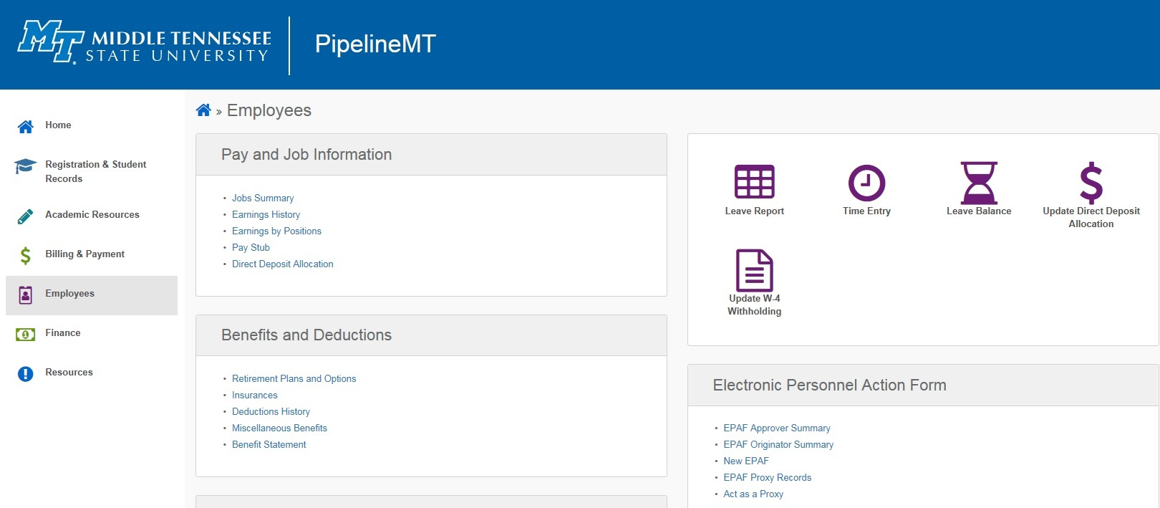
Find Your Leave Report
First click the Employees Link
Next click the Leave Report Icon

Slide 4
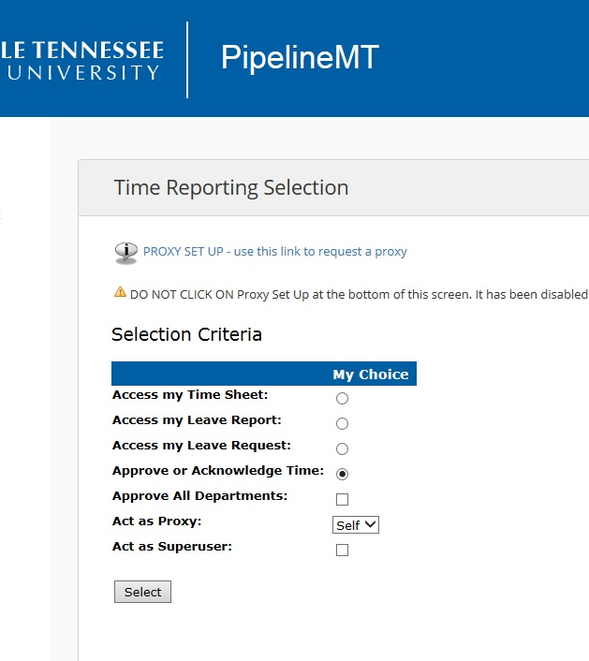
Time Reporting Selection Page
Employees with Approver and Proxy privileges will see this page. For all other employees go to the Leave Report Selection Page
Click the “Access my Leave Report” choice
Next click the SELECT button
Click “Access my Leave Report”
Note: “Approve or Acknowledge Time” is the default

Slide 5
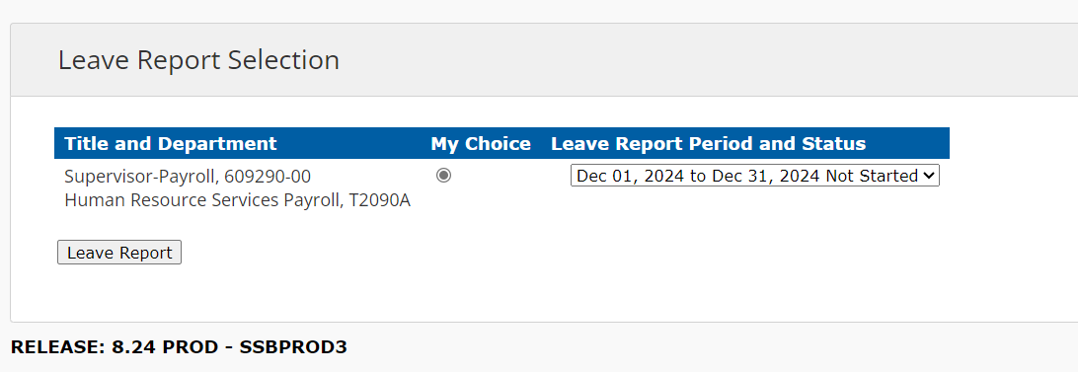
Leave Report Selection Page
The default “Leave Report Period and Status” is the latest month. You have access to the three previous months’ leave reports from this page.
Choose your leave report period and click the LEAVE REPORT button.

Slide 6
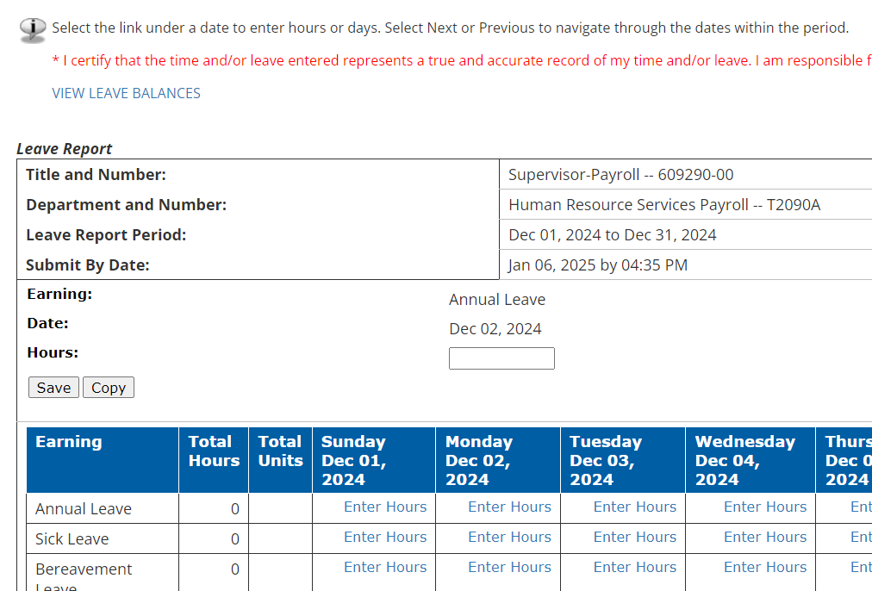
Leave Reporting Detail Page – Entering one day at a time
Click the “Enter Hours” link under the appropriate date and leave type to enter your hours
Check the “Earning:” line to make sure you are entering the correct type of leave
Check the “Date:” to make sure you are on the correct date
Enter hours in the box across from the “Hours:” line
Click SAVE

Slide 7
Partial Hours Grid
Minutes | Partial Hour
1-6 | .1 hour
7-12 | .2 hours
13-18 | .3 hours
19-24 | .4 hours
25-30 | .5 hours
31-36 | .6 hours
37-42 | .7 hours
43-48 | .8 hours
49-54 | .9 hours
55-30 | 1 hour
Report hours using whole hours and tenths of an hour only. Do not use leading or ending zeros.
Example: 7.5, 5, 4.3, .7

Slide 8
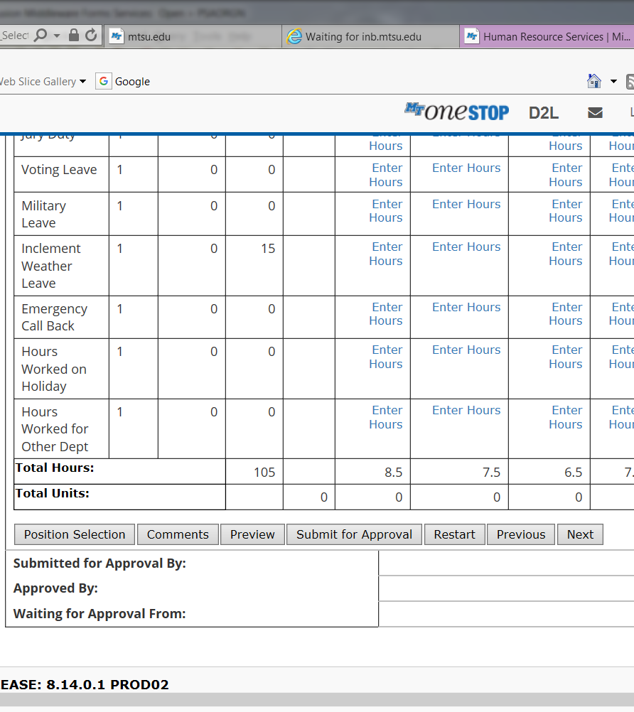
Navigating the Control Buttons
Position Selection: Click this button to return to the “Leave Report Selection” page
Comments: Comments can be added to the leave report by clicking this button
Preview: Click to preview your report once hours have been entered
Submit for Approval: click this button ONLY after all leave is entered, previewed by you, and is ready for approval
Restart: Clears ALL entries made
Previous/Next: takes you to the previous or next seven days in the report

Slide 9
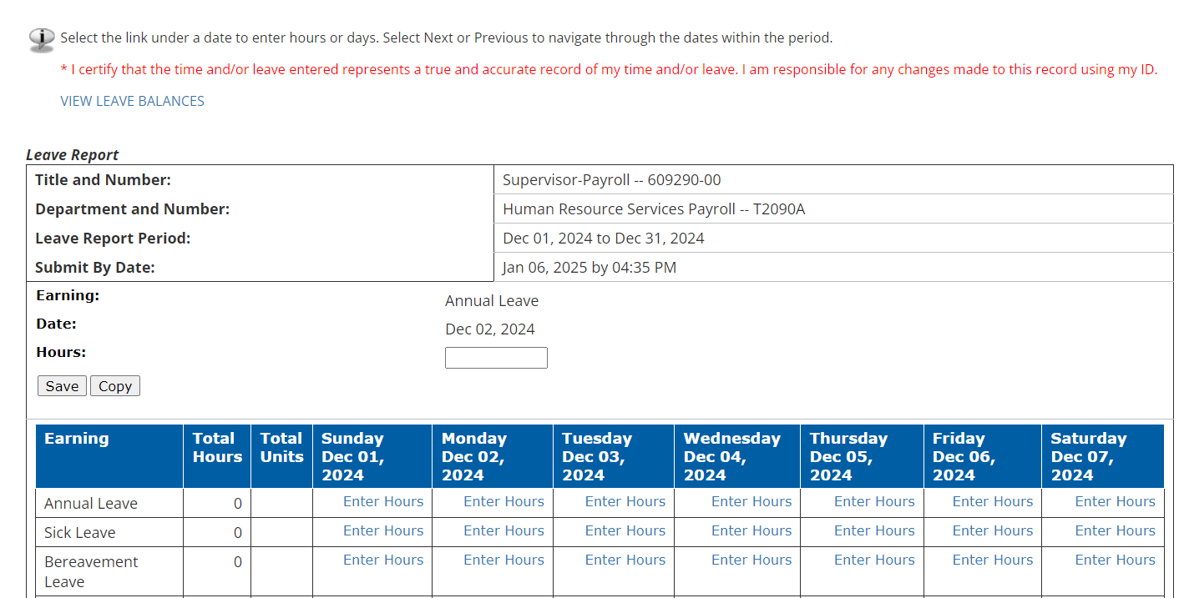
Leave Reporting Detail Page – Entering Multiple Days at one time
Use this method when entering the same number of hours under the same type of leave for multiple days
Click the “Enter Hours” link under the appropriate date and leave type to enter your hours
Check the “Earning:” line to make sure you are entering the correct type of leave
Check the “Date:” to make sure you are on the correct date
Enter hours in the box across from the “Hours:” line
Click COPY and you will move to a calendar type grid with checkboxes for each day

Slide 10
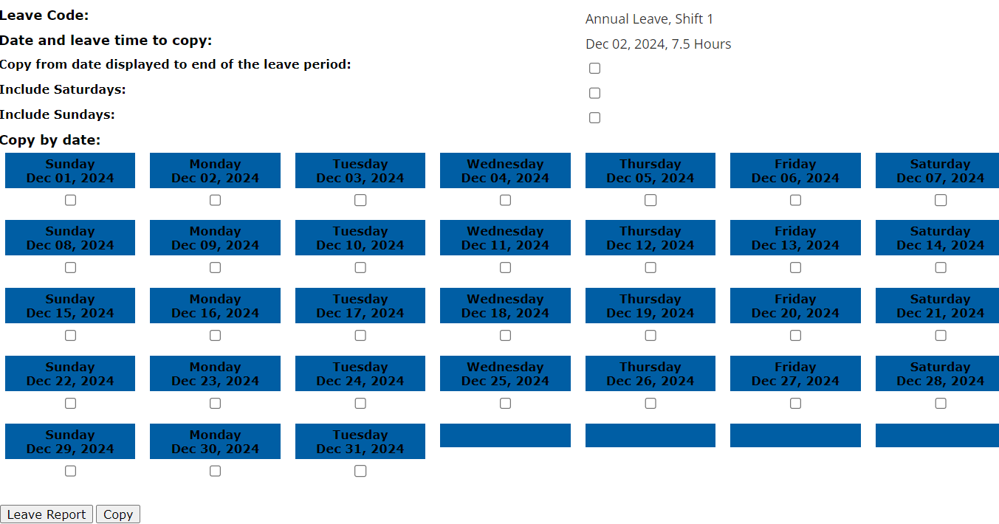
Continued…
Entering Multiple Days
Click the checkbox for days that you wish to enter leave or click the “Copy from date displayed to end of the leave period” box. (This will copy leave to each day of month.)
Click the COPY button
Click the Leave Report button and you will be taken back to the leave report page.
Preview your leave report to make sure all entries are correct before submitting for approval

Slide 11
Submitting Your Leave Report for Approval
Once you have entered your leave, always PREVIEW your report to make sure all entries are correct. Once you are satisfied with your report click the SUBMIT FOR APPROVAL button.
Note: You no longer have access to make any changes to your leave once your report is submitted.

Slide 12
Notes and Information
9/10 Month Faculty accrue 7.5 hours of Sick Leave each month from August-April
Only Administrative employees and 12-Month Faculty accrue annual leave
Always use sick leave, not annual leave, when you are sick regardless of your Sick Leave balance.
Submission and approval deadlines are found on the HRS website at Leave Reporting for Faculty and Administrators – Human Resources
Employees may view their leave reports through PipelineMT > Employees link > Leave Balance icon
For more information or assistance contact
Lori Pugh, Payroll Supervisor
Lori.Pugh@mtsu.edu
615-898-5129
Lisa Jones, Assistant Director of Payroll Services
Lisa.Jones@mtsu.edu
615-898-2168

